Slide 1
ASR Project6
Multilingual ASR and Cross-Language Transfer
SS2025
by
Jingyu Han
Xuanhan Chen
Haiming Deng
Shanshan Xu

Slide 2
PPT模板 http://www.1ppt.com/moban/
1
Data&Task Setup
CONTENTS
2
Model&Training
3
Ablation Study
&Zeroshot
4
4.Probing&Viz

Slide 3
Data&Task Setup
PART 01
Notes:
模板来自于：第一PPT https://www.1ppt.com/

Slide 4
TASK
TRAINING LANGS
SpecAugment or No Aug
Ablation Test
ZEROSHOT LANGS

Slide 5
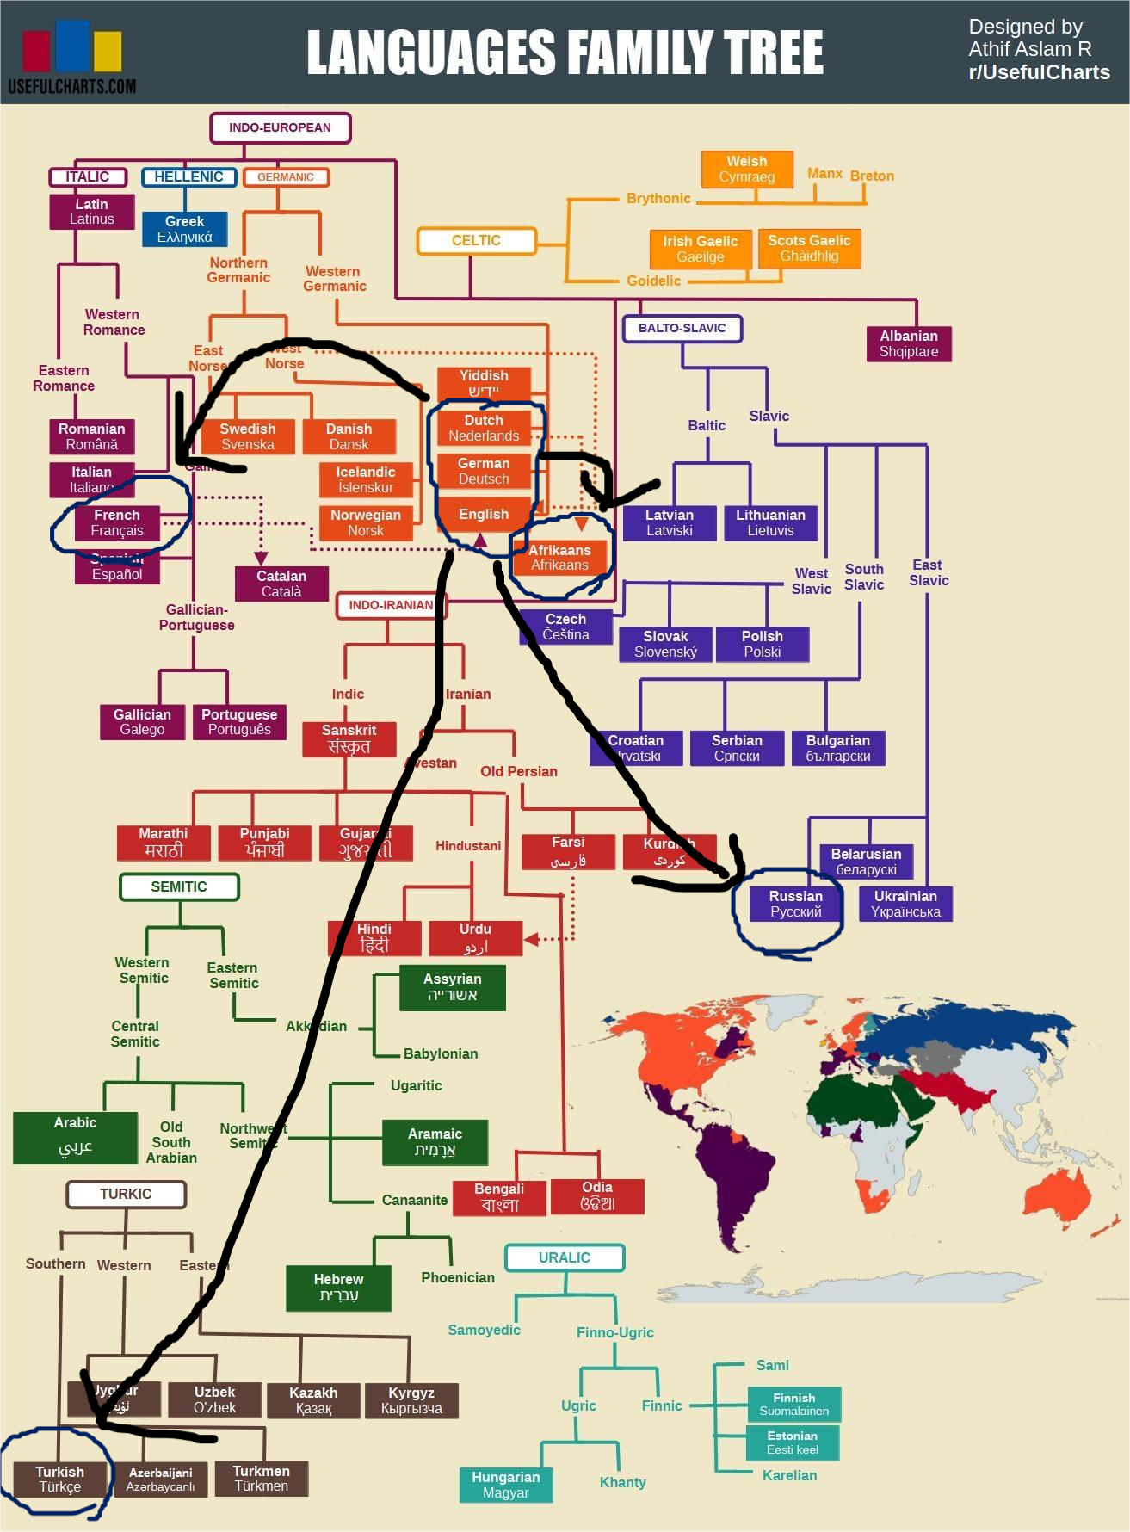
LANGUSGES SETUP
ZEROSHOT
AFRIKAANS
WEST GERMANIC
FRENCH
ENGLISH
RUSSIAN
GERMAN
TURKISH
DUTCH
JAPANESE
CHINESE

Slide 6
LANGUAGE DISTANCE
ZEROSHOT
DISTANCE LEVEL
AFRIKAANS
0
WEST GERMANIC
FRENCH
1
ENGLISH
RUSSIAN
2
GERMAN
TURKISH
3
DUTCH
JAPANESE
4 OR INFINITE
CHINESE
5 OR INFINITE

Slide 7
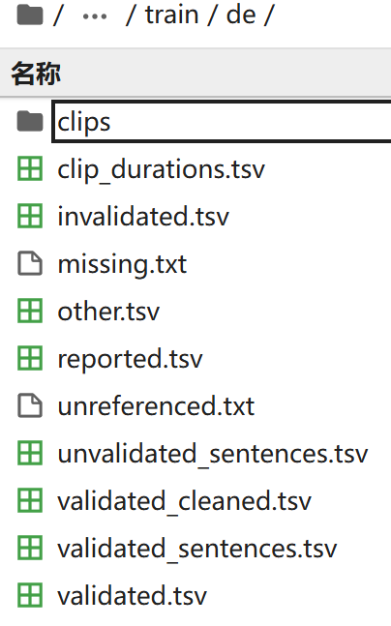
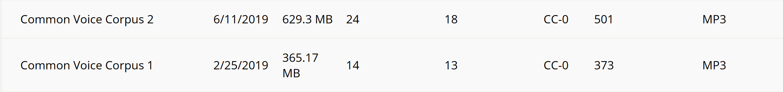
MERGE DATA
ENG:
NOT ALL DATA USEFUL!!!
DUTCH
GERMAN

Slide 8
PREPROCESSING
REMOVE DUL
&UNREFERED
COLLECT
MERGE
DIVIDE
Collect data from different dataset
Merge the data
Remove dulplications
and unreferenced audios
Divide the dataset into
Training
Validation
Test

Slide 9
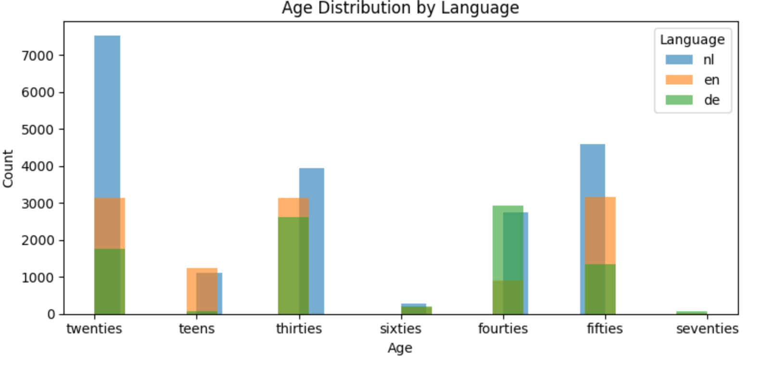
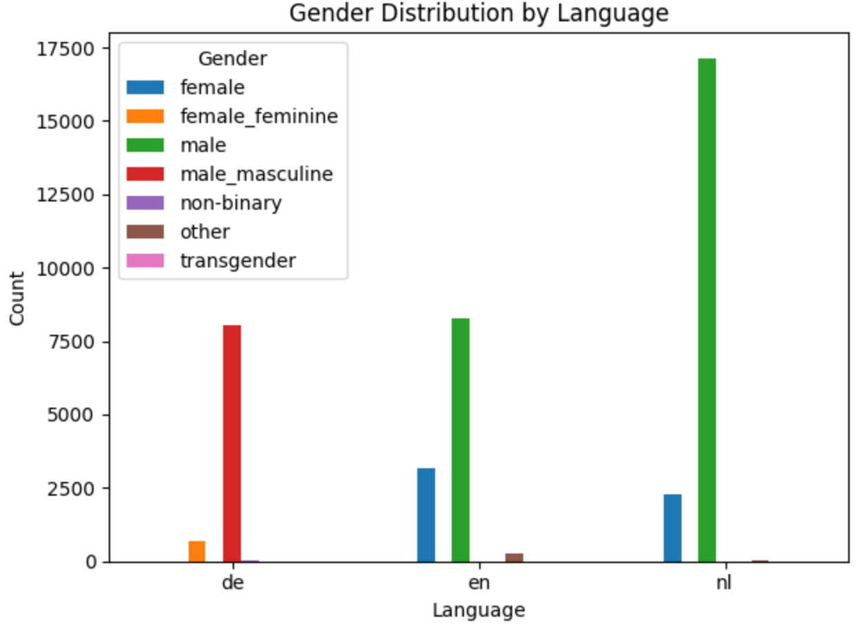
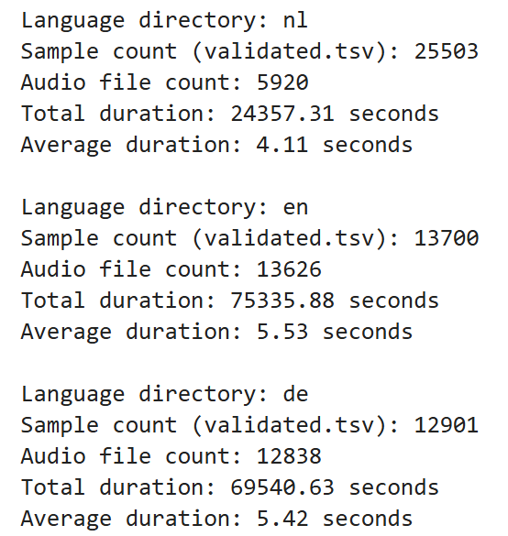
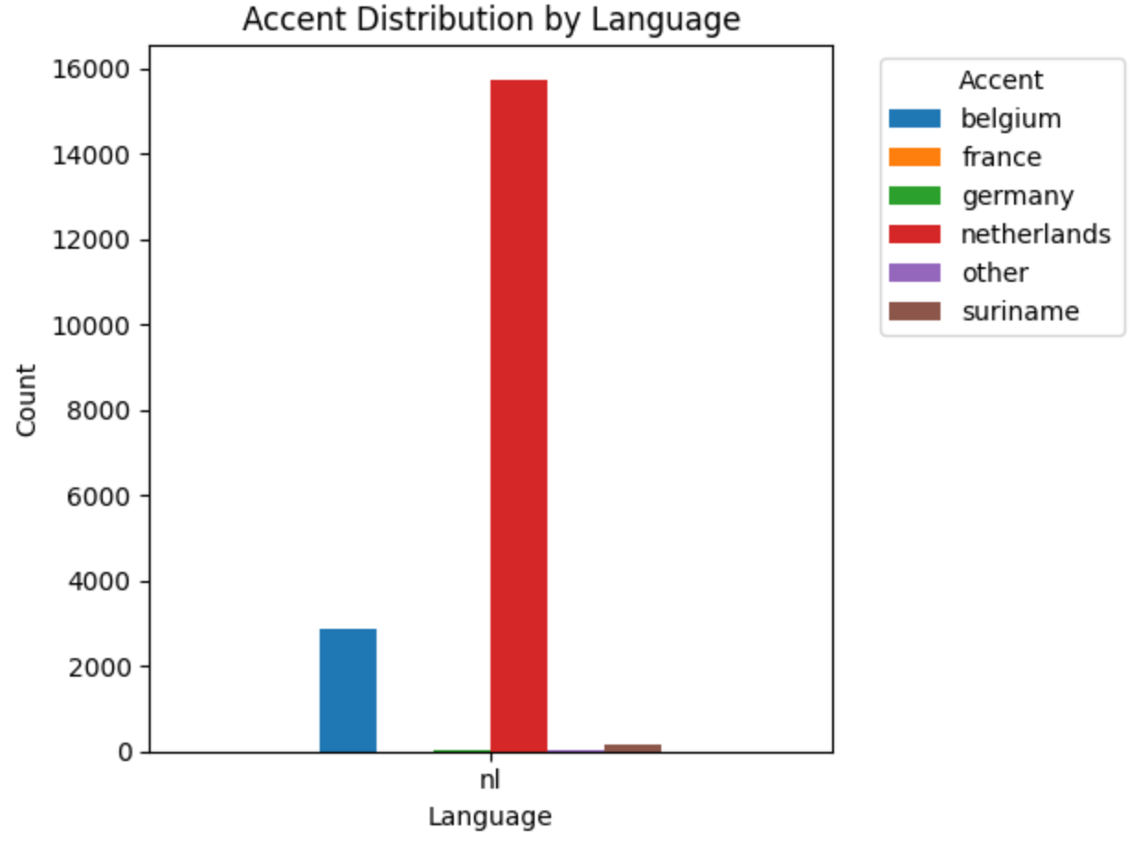
TRAINING DATA DISTRIBUTION
LENGTH
GENDER
AGE
ACCENTS

Slide 10
Model&Training
PART 02

Slide 11
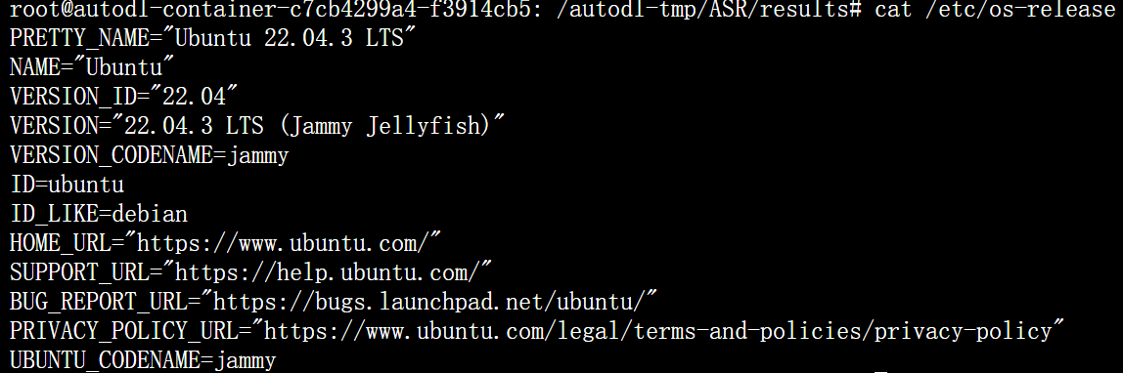
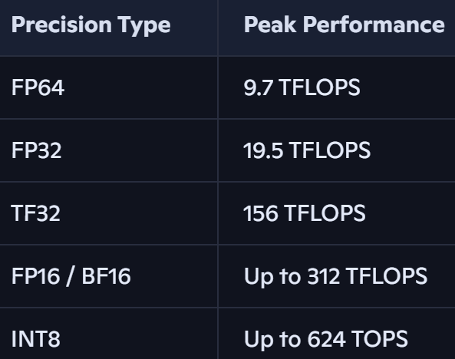
Environment SETUP
Python 3.10.8
Ubuntu 22.04
AUTODL.COM
NVIDIA A100 PCIE
CUDA12.2+TORCH2.1.2

Slide 12
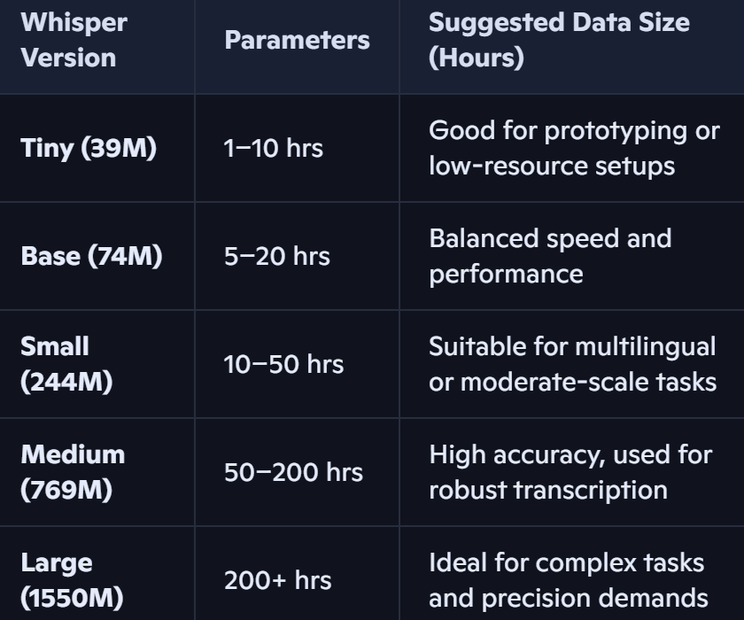
WHISPER
CELOSS
VERSIONS
TRANSFORMER DECODER
TRANS TEXT
TRANSFORMER ENCODER
approximately 50h data
AUDIO

Slide 13
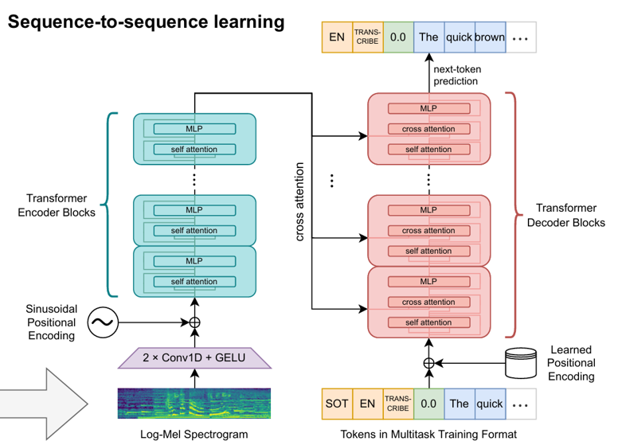
WHISPER-MEDIUM
CELOSS(LOGITS,TARGETS)
X24
X24
AUDIO 16KHZ
DEFAULT LENTH = 30S

Slide 14
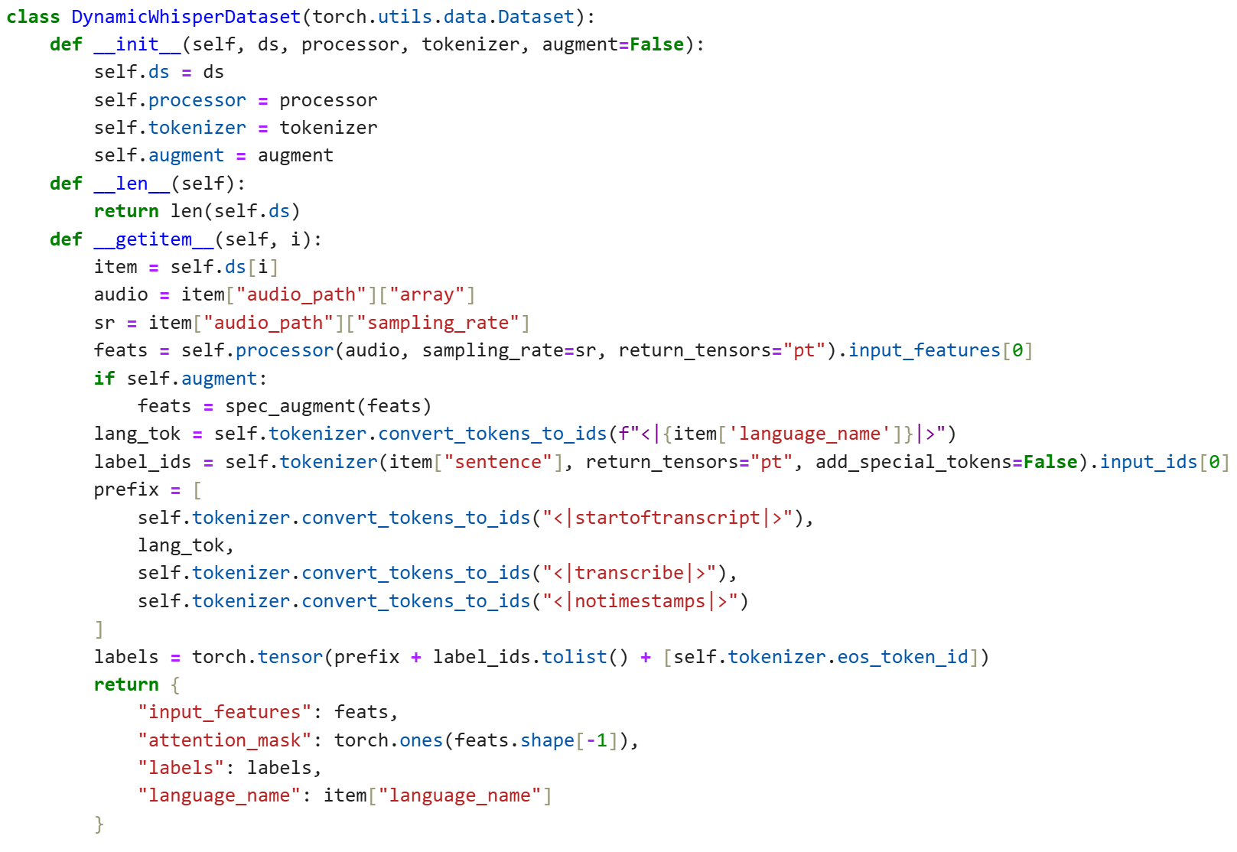
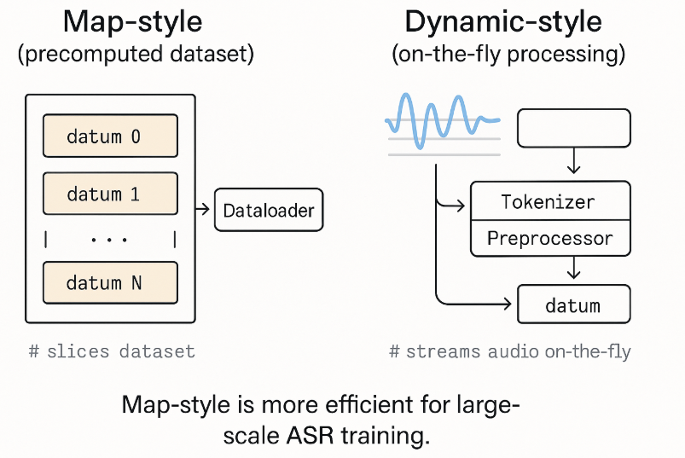
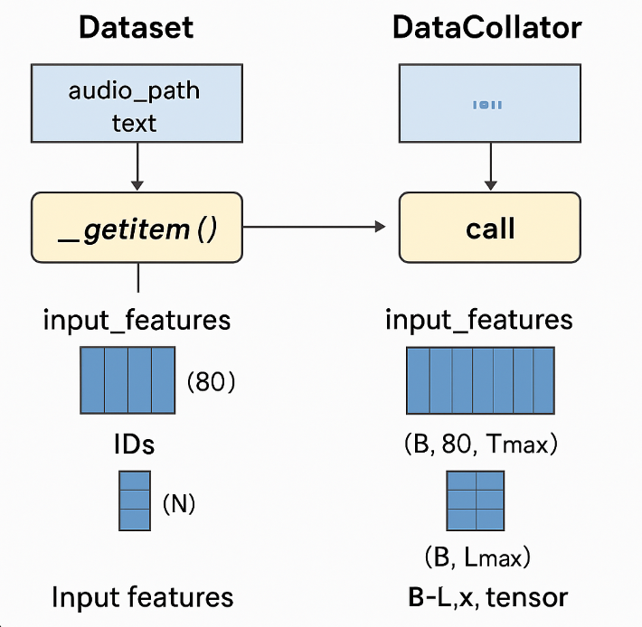
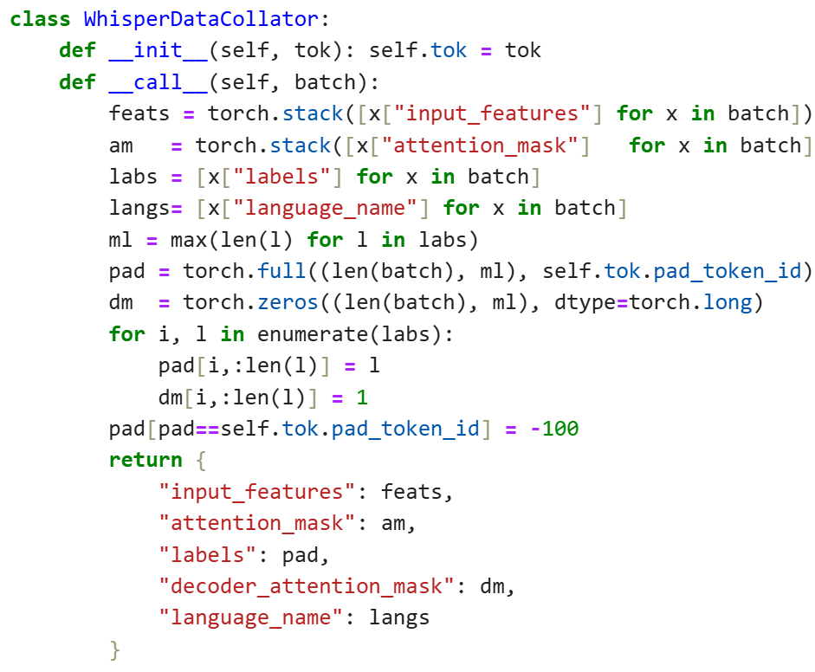
DYNAMIC DATALOADER
MAP
It's static — features are computed and stored before training.
Fast at runtime since data is already encoded.
Usually used when:
You have plenty of disk space.
You want deterministic preprocessing.
You don’t need online data augmentation.
DYNAMIC DATALOADER
Supports SpecAugment and other dynamic transformations.
More flexible, but slightly slower per batch.
Ideal when:
You want to save disk space.
You need random augmentations (like masking).
You're experimenting with freezing layers or multilingual adaptation.

Slide 15
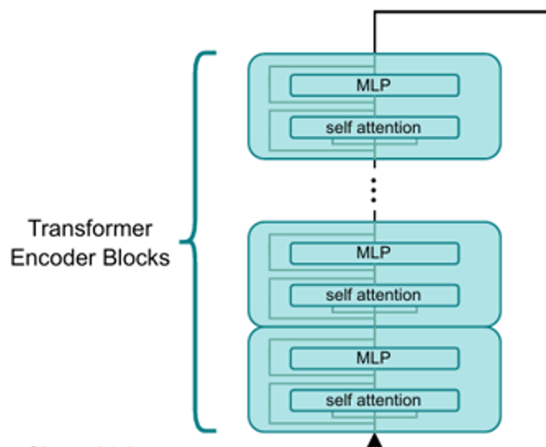
ACCERLEATION
WHY first 75% percent?
PEFT-layer frozen
FP16
Gradient Accumulation
Early Layer
Common Feature
Capture fine-grained, task-agnostic details Examples:
In audio: frequency patterns, phonemes, harmonics
Higher Layer
High level feature
Encode abstract, task-specific semantics Examples:
In audio: linguistic meaning, speaker traits, intent
We froze the first 75% of the Transformer encoder blocks.

Slide 16
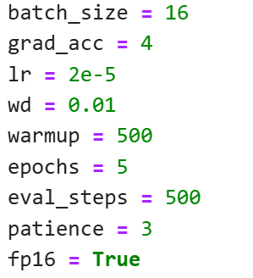
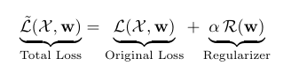
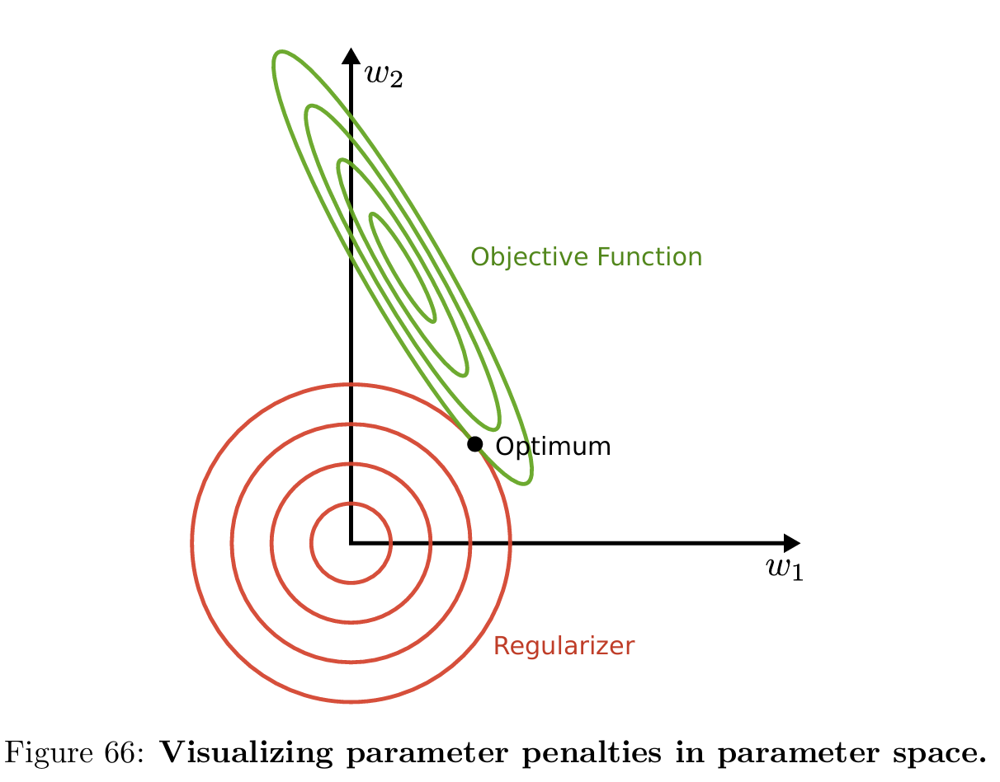
OTHER TECHNI
learning rate scheduler
Early stopping
02
01
get_linear_schedule_with_warmup
IF training loss ↓ but val loss ↑
Stop training to avoid overfitting
for balancing the languages
we use macro wer as controller
patient=3
Regularzation
03
l2 Reluarzation, also called weight decay
rigde regression
params penalties
04

Slide 17
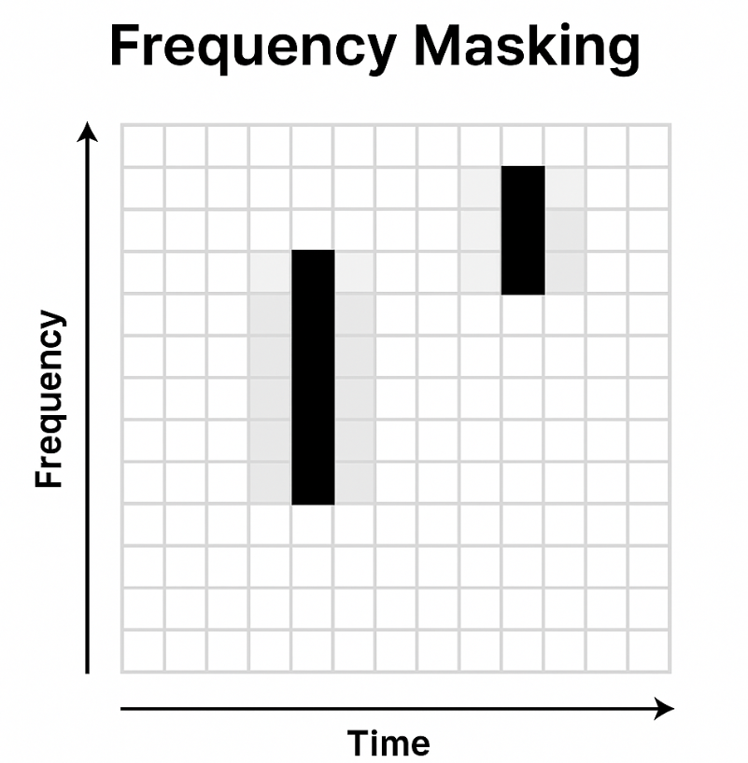
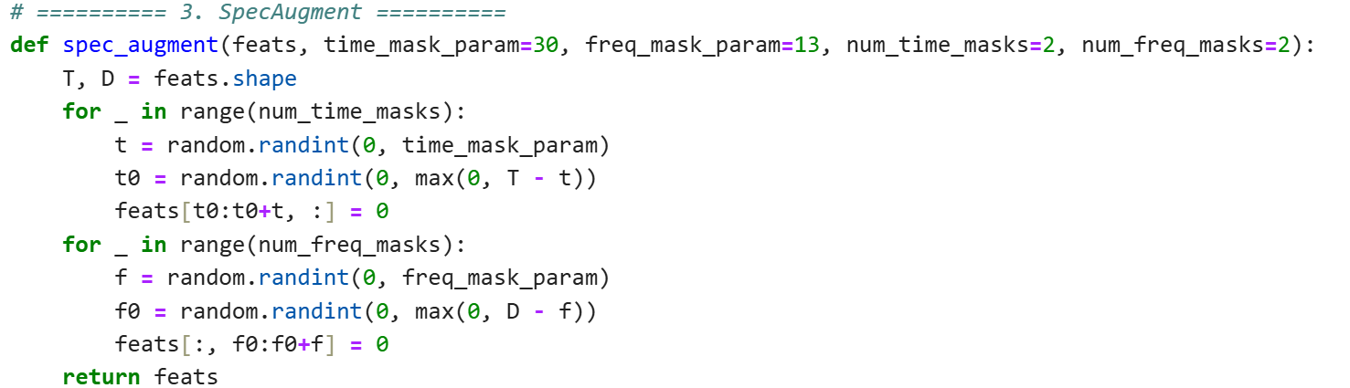
SpecAugmentation
Methods
01
It randomly selects frequency bands (horizontal slices in a spectrogram) and masks them (sets them to zero), simulating scenarios where certain frequency information is missing—like due to noise or channel distortion.
it helps improve model robustness and generalization, especially in low-resource or noisy environments.
02
Purpose

Slide 18
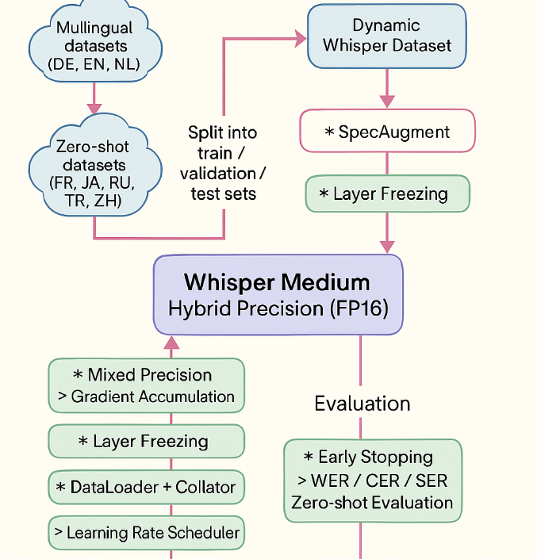
ALL PIPELINE

Slide 19
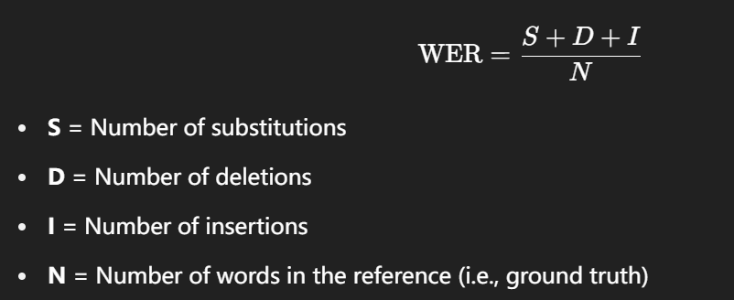
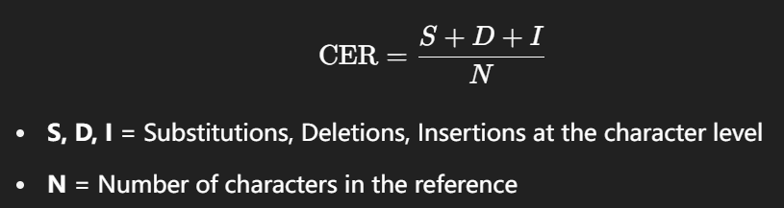

EVAL MATRIX
WER
CER
SER

Slide 20
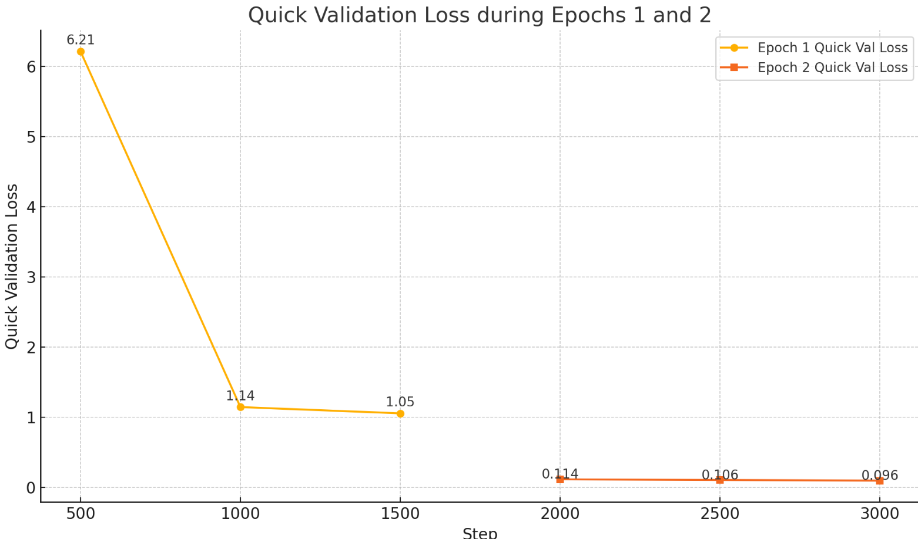
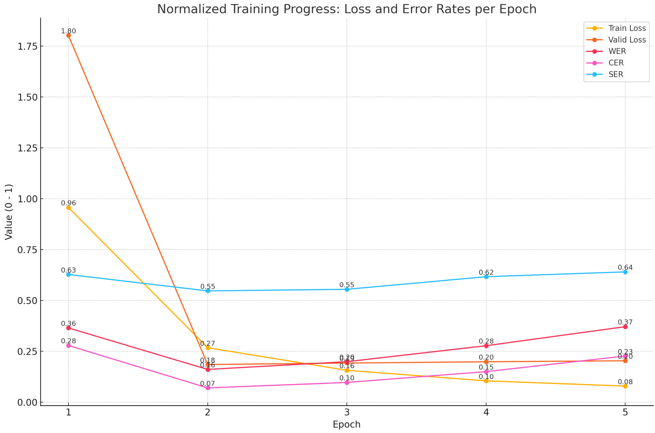
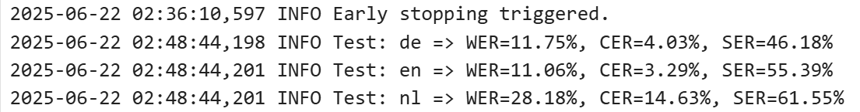
Loss curve
TESTSET RESULT:

Slide 21
Zeroshot Test
&Ablation study
PART 03

Slide 22
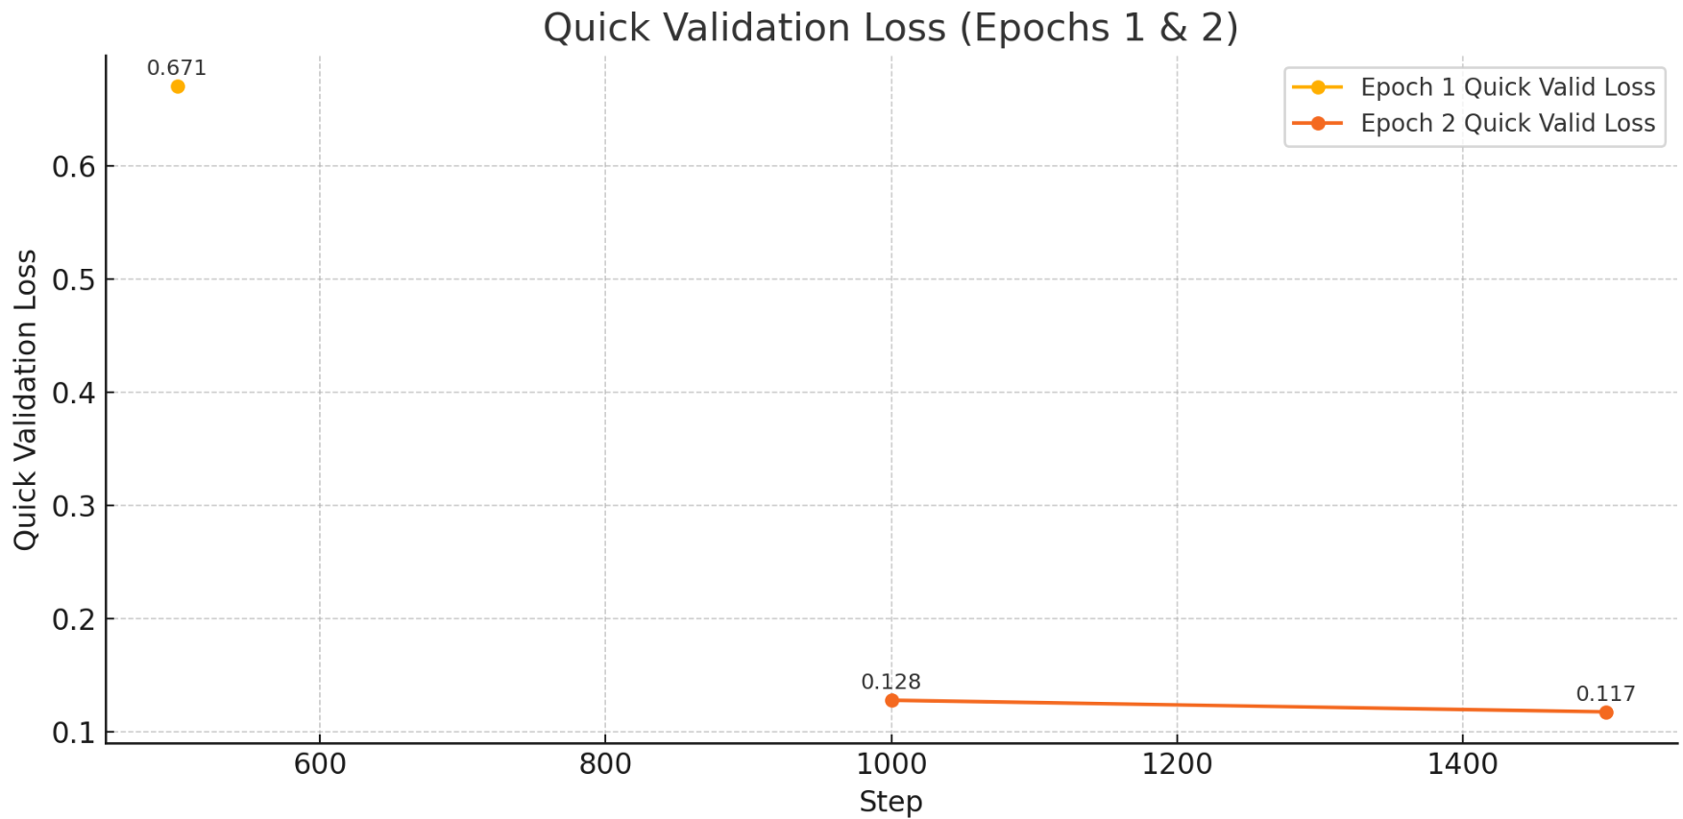
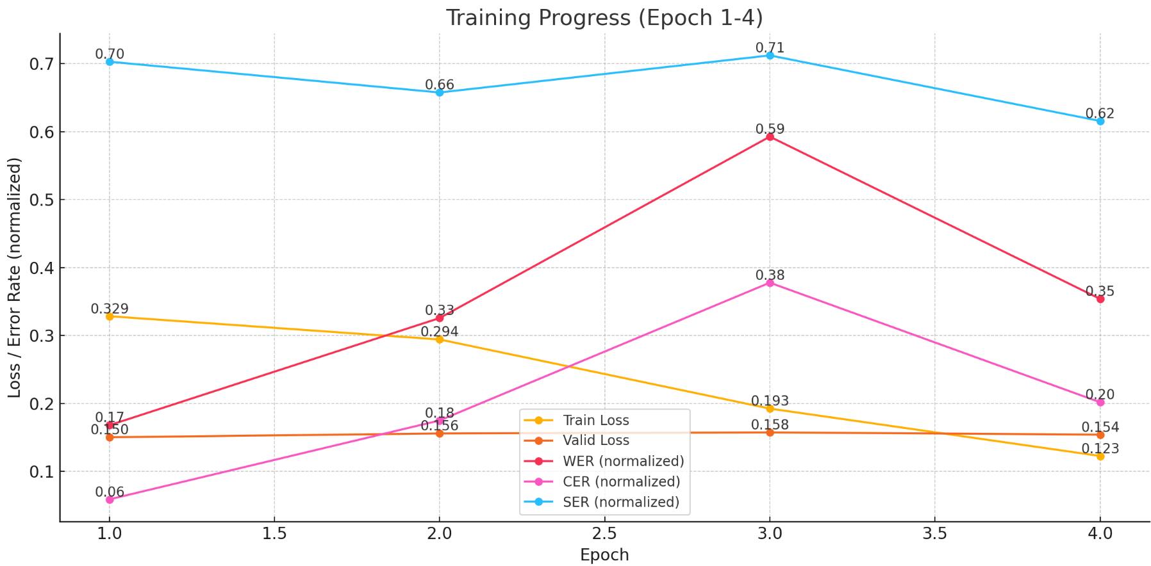
ABLITION STUDY-DE/NL

Slide 23
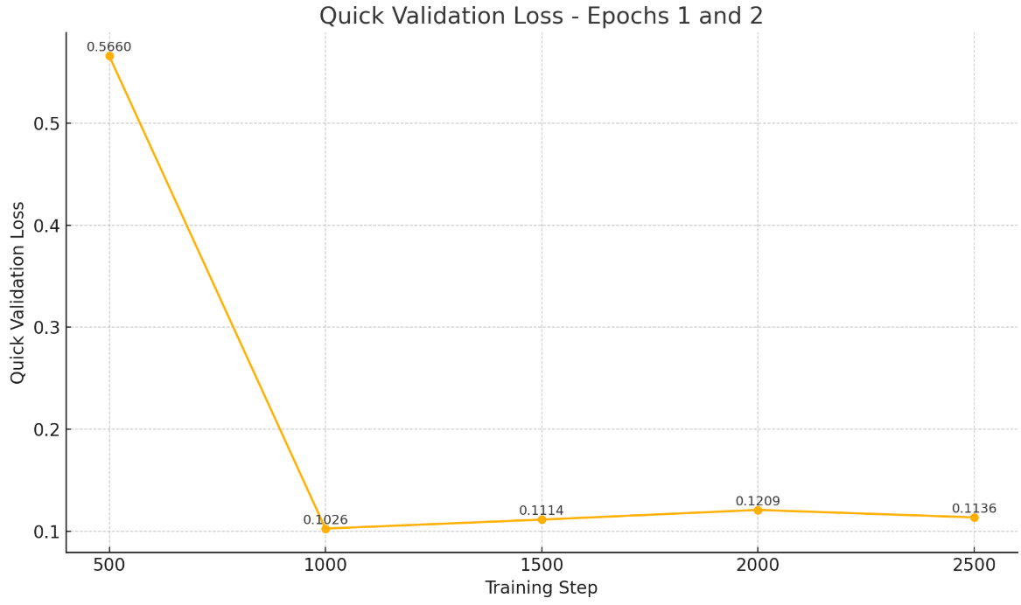
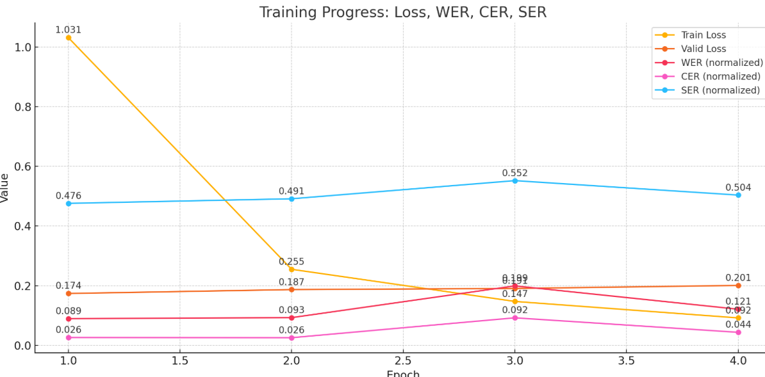
ABLITION STUDY-DE/EN

Slide 24
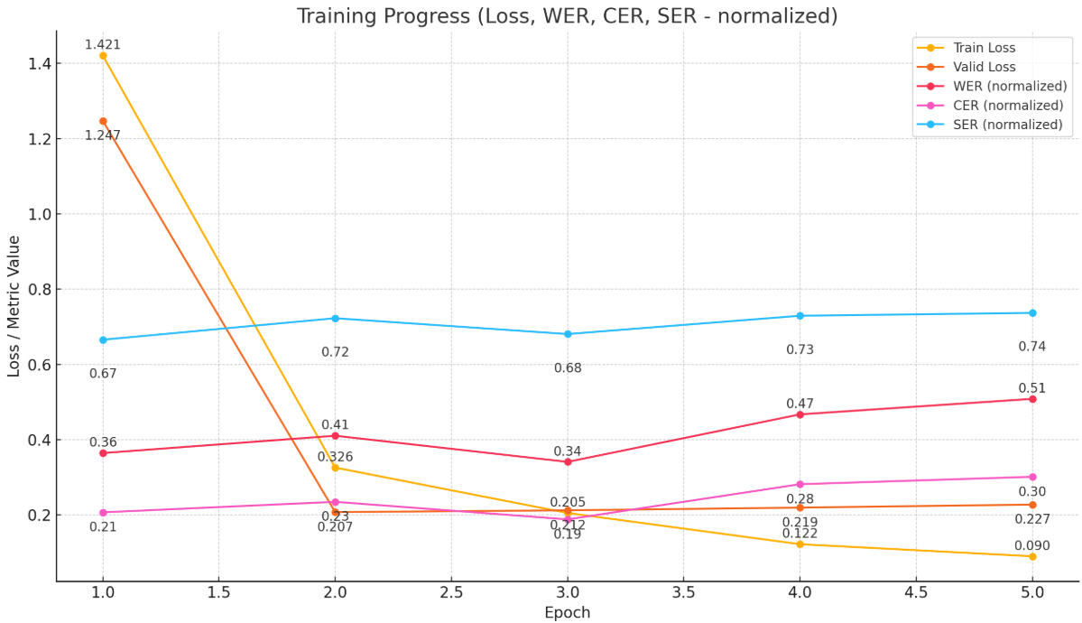
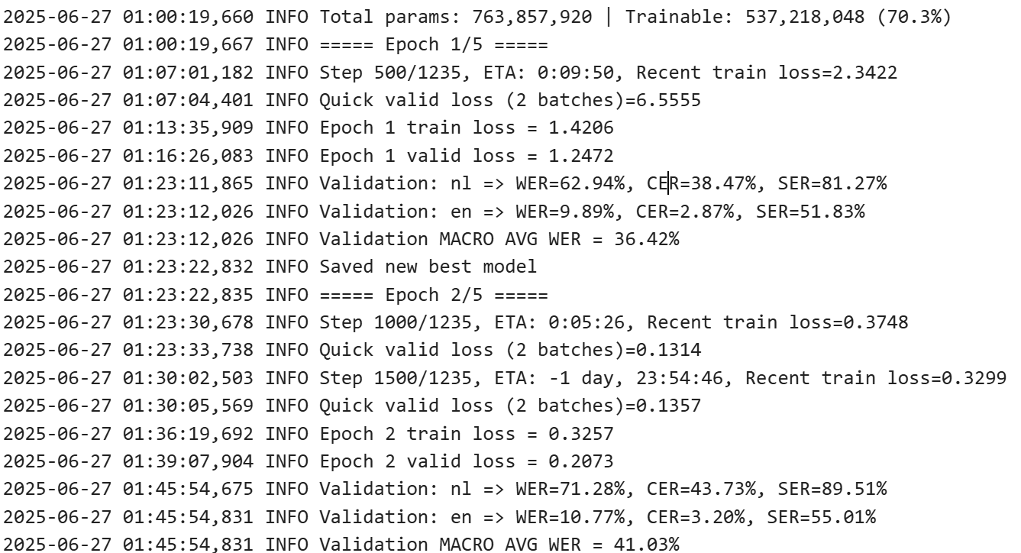
ABLITION STUDY-NL/EN
HOWEVER the best model is in epoch1!
BECAUSE we use the MACRO WER/CER/SER
for balancing the languages

Slide 25
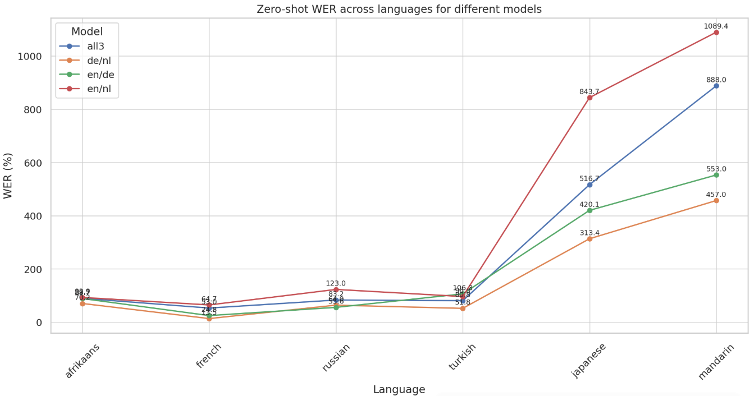
ZERO-SHOT TEST
Generally in line with intuitive expectations

Slide 26
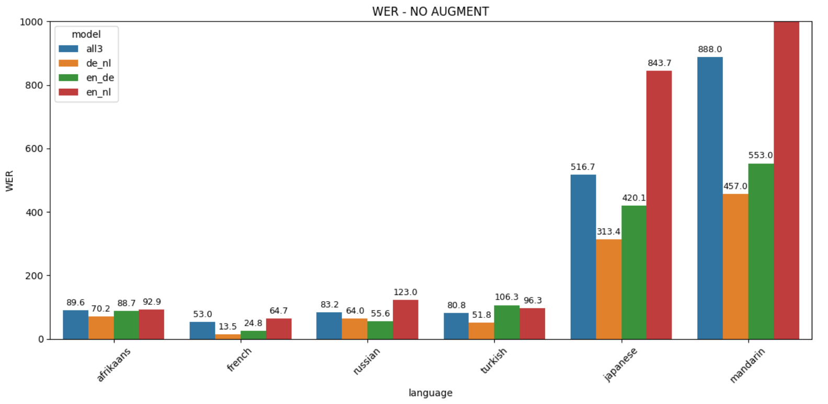
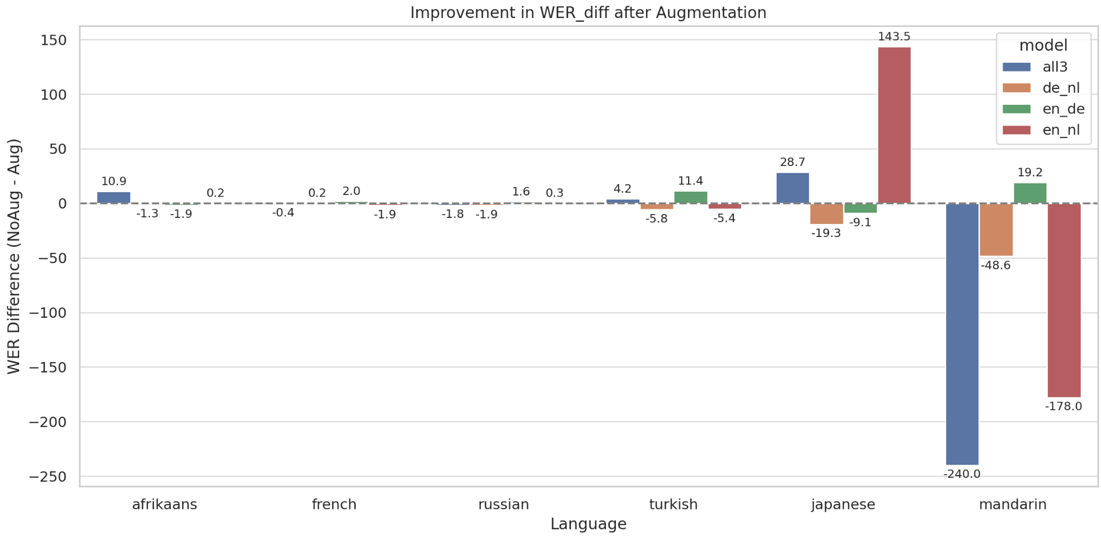
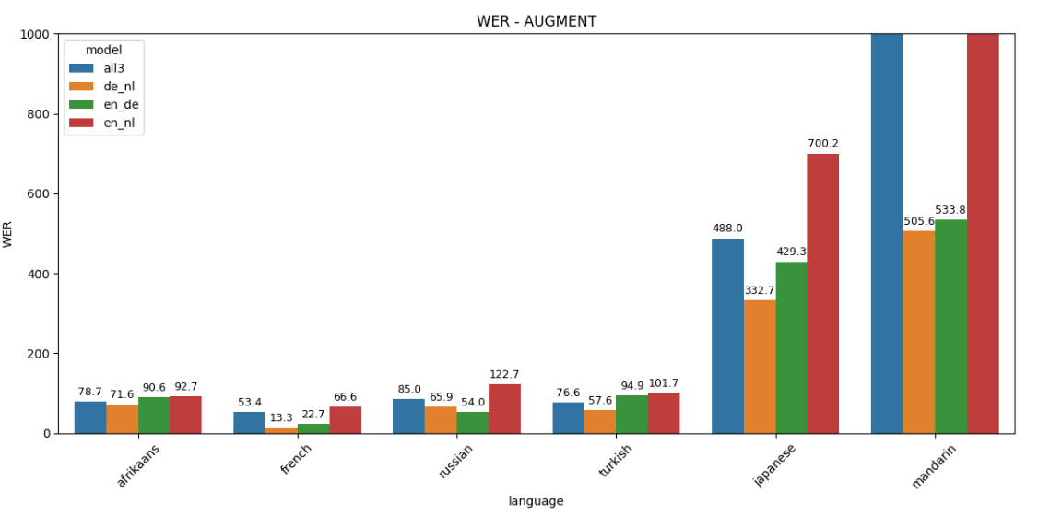
AUGMENT EFFECT

Slide 27
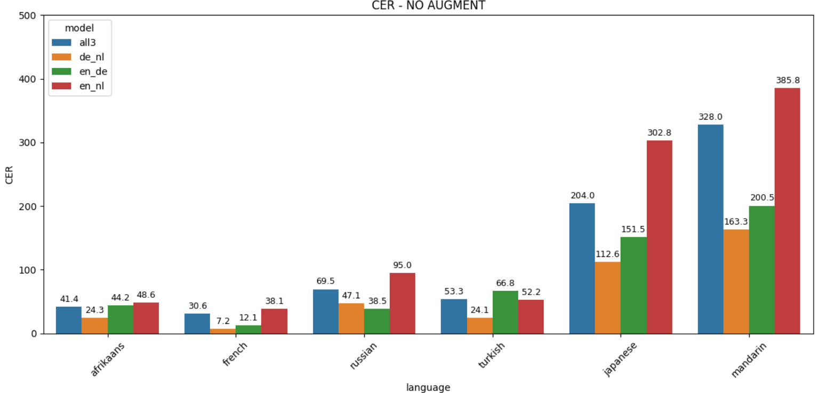
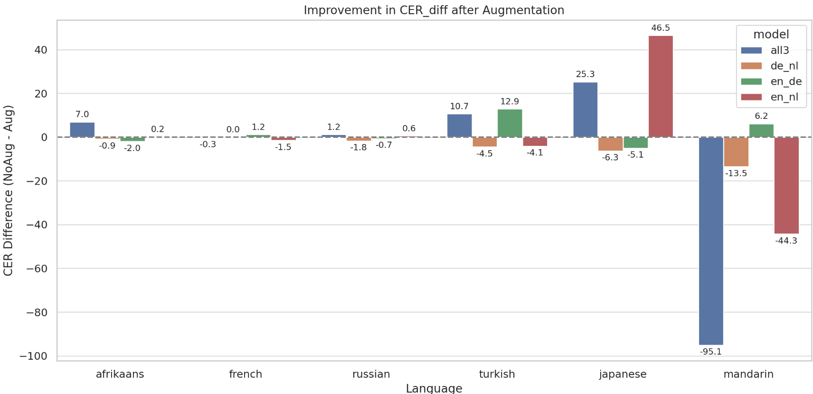
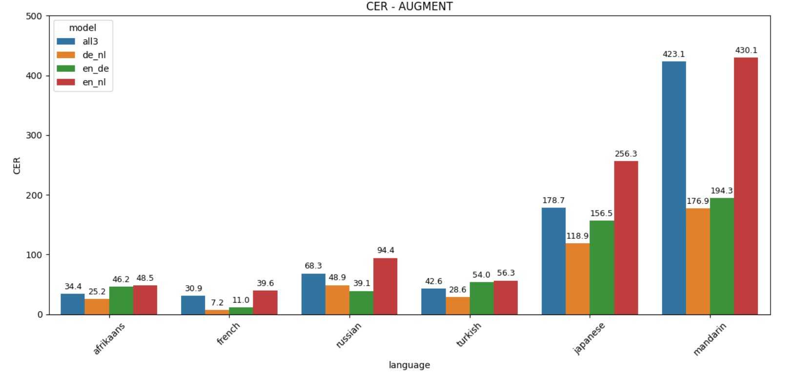
AUGMENT EFFECT

Slide 28
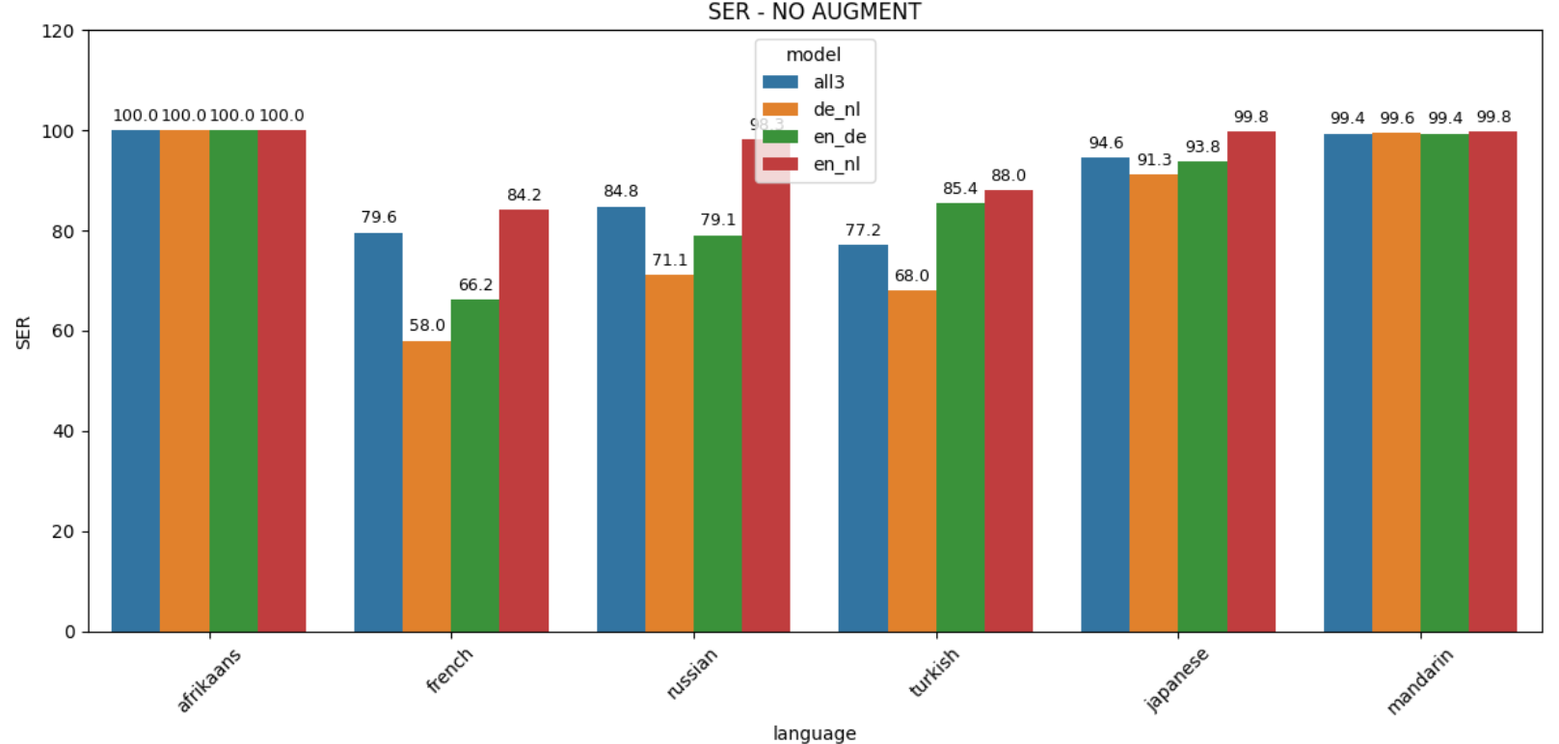
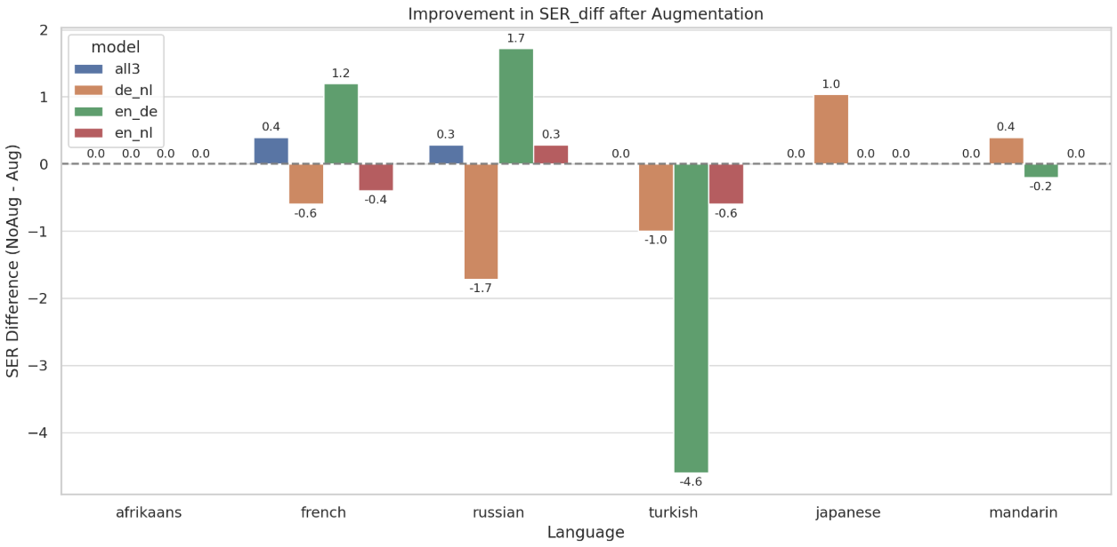
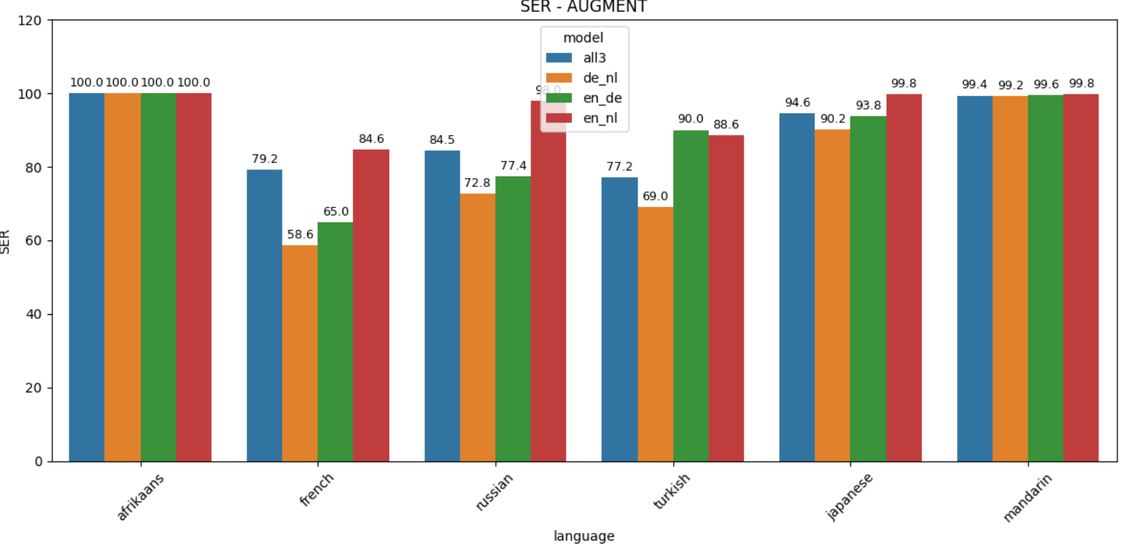
AUGMENT EFFECT

Slide 29
Probing&
viz shared representations
PART 04

Slide 30
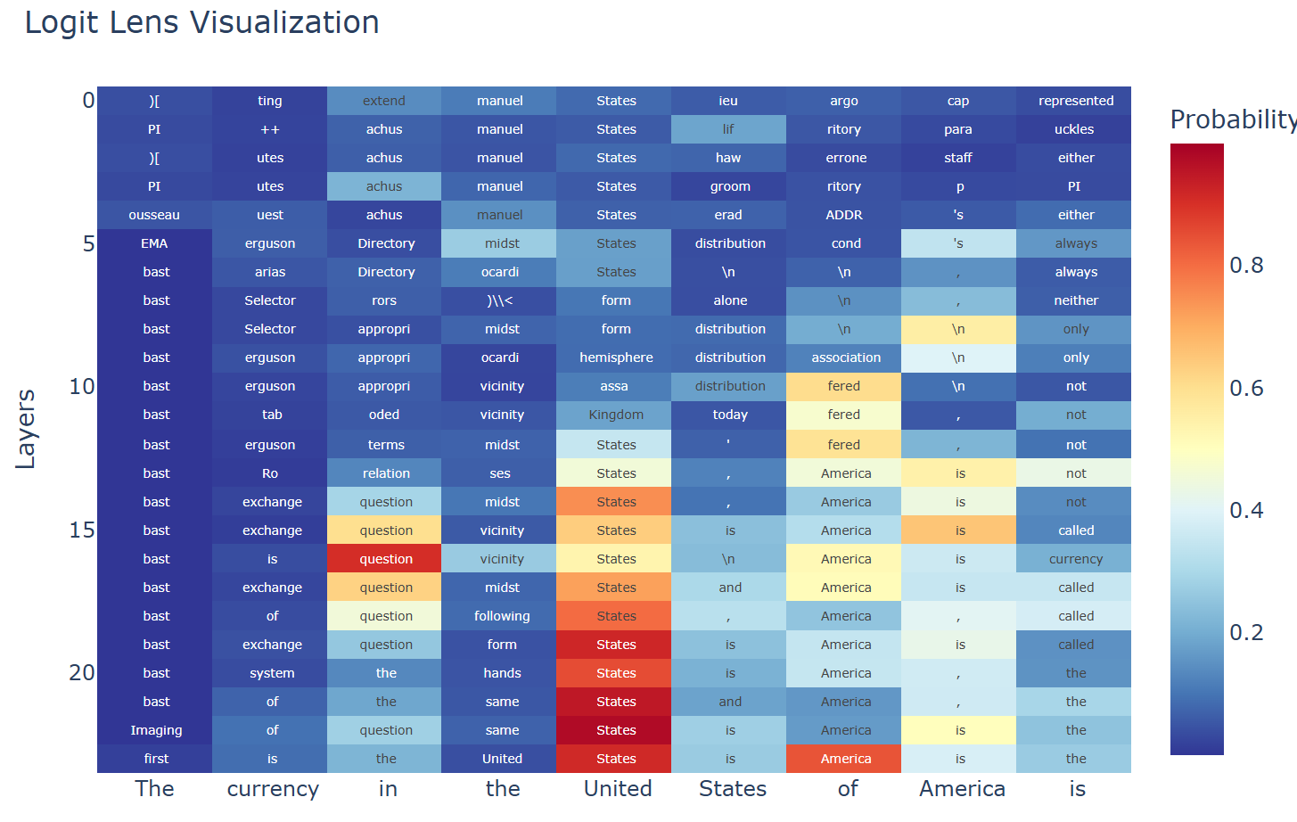
WHY DON’T WE VIZ ATTENTION
A few samples are not representative of the whole language

Slide 31
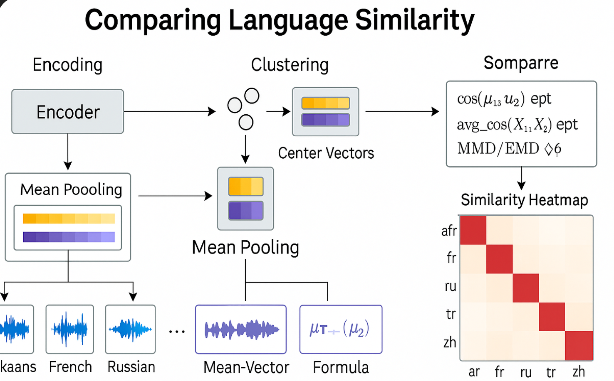
WHAT WE PREPARE TO DO

Slide 32
THANKS FOR LISTENING
JINGYU HAN / XUANHAN CHEN / SHANSHAN XU/HAIMENG DENG
ss 2025 ASR

